Slide 1
When NOT to Use PowerShell for Managing Azure Resources
Parts I & II
HELLO
my name is
PowerShell in Action
Fri 02-June-2017 10:10 AM – Adams – Part I
10:50 AM – Washington – Part II
Bill Wilder, CTO, Finomial Corporation
Bill Wilder

Slide 2





7x recipient
cto
author
founder

Slide 3
What questions will this talk answer?
PART I - OVERVIEW
Key concepts: What are ARM templates
Why ARM templates matters
See what they are and where they are used in Azure
Invoke ARM templates from PowerShell
Review gallery resources for templates (maybe)
PART II – ADVANCED @ 10:50
Review structure of a JSON template
Review documentation
Create a template / azuredeploy.json. & azuredeploy.parameters.json.
Demo some tools for editing/modifying them
Invoke ARM templates from PowerShell

Slide 4
PART I
OVERVIEW

Slide 5
Key Concepts: What are ARM Templates?
(Level set from Azure Portal)
Azure Resources
VM, storage account, network, firewall, database, …
Azure Resource Groups
Named collection of Azure Resources
RBAC, Policies, Billing Unit, Lifecycle Unit
Logical unit of deployment
Infrastructure as code (control plane)
Notes:
Show K1 – all the resources
https://portal.azure.com/#create/Microsoft.Template/uri/https%3A%2F%2Fraw.githubusercontent.com%2FAzure%2Fazure-quickstart-templates%2Fmaster%2F201-1-vm-loadbalancer-2-nics%2Fazuredeploy.json

Slide 6
ARM Template JSON File Structure
{
"$schema": "..."
"contentVersion": "...",
"parameters": {...},
"variables": {...},
"resources": [...],
"outputs": {...}
}

Slide 7
Why do ARM Templates Matter?
Tool ecosystem (“the chosen one”)
Common collaboration format/structure
Does not require PowerShell
Which is kinda the point ☺
Deployments getting more sophisticated
More possible services = more moving parts
More sophisticated usage = more moving parts
Separation of Duties
Stability & Predictability with –Mode Complete
Notes:
Show K1 – all the resources
No Pets rule - prefer cattle
https://portal.azure.com/#create/Microsoft.Template/uri/https%3A%2F%2Fraw.githubusercontent.com%2FAzure%2Fazure-quickstart-templates%2Fmaster%2F201-1-vm-loadbalancer-2-nics%2Fazuredeploy.json

Slide 8
Why do ARM Templates Matter?
Tool ecosystem (“the chosen one”)
Common collaboration format/structure
Does not require PowerShell
Which is kinda the point ☺
Deployments getting more sophisticated
More possible services = more moving parts
More sophisticated usage = more moving parts
Separation of Duties
Stability & Predictability with –Mode Complete
Notes:
Show K1 – all the resources
https://portal.azure.com/#create/Microsoft.Template/uri/https%3A%2F%2Fraw.githubusercontent.com%2FAzure%2Fazure-quickstart-templates%2Fmaster%2F201-1-vm-loadbalancer-2-nics%2Fazuredeploy.json

Slide 9
Invoke ARM Template from PowerShell
Azure PowerShell Cmdlets
Install-Module AzureRM
Import-Module AzureRM
Execute from PowerShell
New-AzureRmResourceGroupDeployment ` -Mode Complete ` # Incremental -ResourceGroupName $resourceGroupName ` -TemplateFile $templateFilePath ` -TemplateParameterFile $parametersFilePath
Notes:
https://docs.microsoft.com/en-us/powershell/azure/install-azurerm-ps?view=azurermps-4.0.0
Also supports a Uri for template file, which could then reference github or other cloud storage

Slide 10
Questions?

Slide 11
PART II
ADVANCED (or at least more detailed ☺)

Slide 12
ARM Template JSON File Structure
{
"$schema": "..."
"contentVersion": "...",
"parameters": {...},
"variables": {...},
"resources": [...],
"outputs": {...}
}

Slide 13
ARM Template Community Gallery on Github
https://github.com/Azure/azure-quickstart-templates
https://github.com/Azure/azure-quickstart-templates/tree/master/201-1-vm-loadbalancer-2-nics

Slide 14
Tools & Docs
VS Code editor
https://code.visualstudio.com/
ext install msazurermtools.azurerm-vscode-tools
Documentation
https://docs.microsoft.com/en-us/azure/templates/
https://docs.microsoft.com/en-us/azure/azure-resource-manager/resource-group-template-functions
Templates
https://github.com/Azure/azure-quickstart-templates/
Notes:
https://docs.microsoft.com/en-us/powershell/azure/install-azurerm-ps?view=azurermps-4.0.0

Slide 15
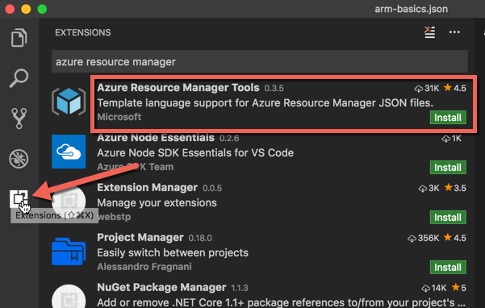
VS Code – installing ARM Tools extension
http://blogs.microsoft.com/blog/2015/11/17/enterprise-security-for-our-mobile-first-cloud-first-world/

Slide 16
Debugging Tips
New-AzureRmResourceGroupDeployment
Test-AzureRmResourceGroupDeployment
-Debug
-DeploymentDebugLogLevel (All, ResponseContent)
https://docs.microsoft.com/en-us/powershell/module/azurerm.resources/new-azurermresourcegroupdeployment?view=azurermps-4.0.0

Slide 17
Questions?

Slide 18

Questions?
Find this slide deck here
See you at Boston Azure
bostonazure.org
Bill Wilder @codingoutloud
codingoutloud@gmail.com
blog.codingoutloud.com
linkedin.com/in/billwilder

Slide 19

Notes:
Subliminal ☺ … 0.25

